Slide 1

SUPERSTORE SALES INSIGHTS

Slide 2
This dashboard provides a comprehensive overview of sales performance, customer behavior, product trends, and operational insights, offering valuable data-driven insights for strategic decision-making. It combines key metrics such as sales, profit, shipping costs, and order volumes, visualized across various dimensions like product categories, customer segments, shipping modes, and regions. By presenting these insights through interactive visualizations, the dashboard enables a deeper understanding of sales distribution, profitability, and performance across different time periods, customer demographics, and geographical locations. Designed to highlight trends and outliers, it supports identifying top-performing products, most profitable customer segments, and operational efficiencies, ultimately aiding in optimizing strategies for improved business outcomes
INTRODUCTION

Slide 3
Dataset Details
1
7
Order Date
Customer Segment
2
8
Product Category
Unit Price
3
9
Customer Names
Product Subcategory
4
10
Shipping Cost
City
5
11
Ship Mode
Profit
6
12
Sales
Unit Price

Slide 4
Expected outcome after this analysis?
1
2
3
Accurate return rate analysis to mitigate losses and improve processes.
Clear identification of the best-performing products and categories driving revenue
Insights into the least profitable products to refine inventory and sales strategies

Slide 5
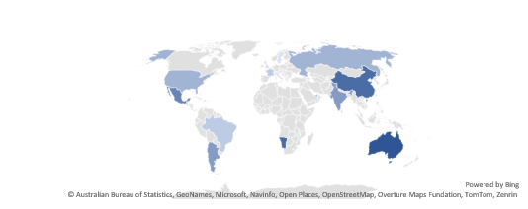
Mock-up Dashboard
25
Total Unit Sold
1952
Total Orders
1.92
Total Sales
224.08
Total Profit

Slide 6


